Slide 1

COMPUTER NETWORKS
(BCSC 0008)
Copyright content, use only with the written permission of presenter mentioned
Lecture 21

Slide 2
Text and Reference Books
Text Books:
Fourouzan B. A. (2004), “Data Communication and Networking”, 4th Edition, McGraw-Hill.
References:
Kurose, J. F. and Ross K. W. (2005), “Computer Networking: A Top-Down Approach Featuring the Internet”, 3rd Edition, Addison-Wesley.
A. S. Tanenbaum (2006), “Computer Networks”, 2nd Edition, Prentice Hall India.

Slide 3
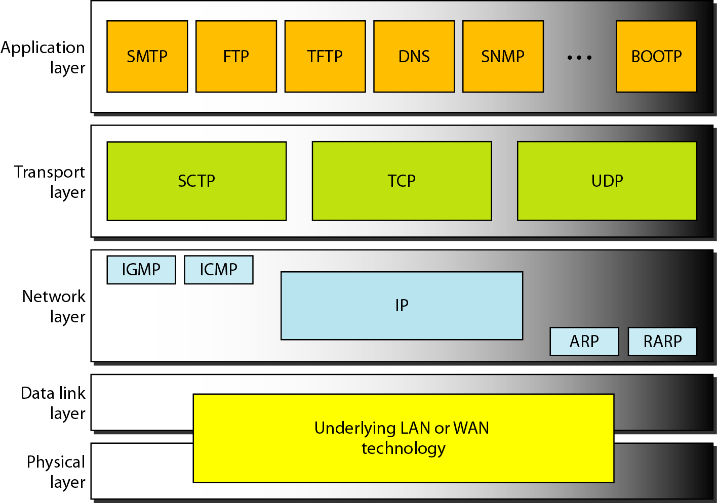
Transport Layer: Introduction

Slide 4
TCP
TCP is a connection-oriented protocol; it creates a virtual connection between two TCPs to send data. In addition, TCP uses flow and error control mechanisms at the transport level.

Slide 5
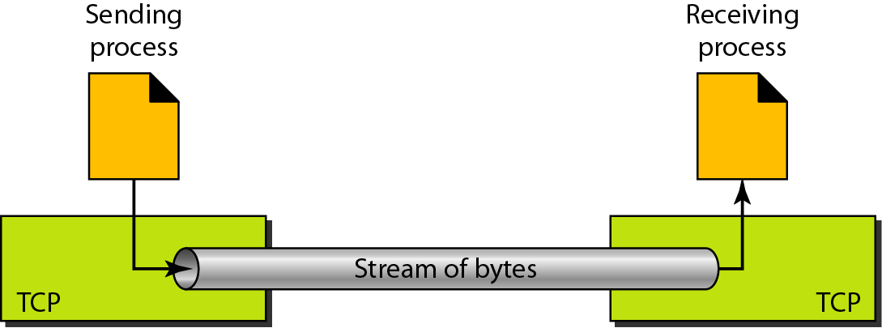
Stream delivery

Slide 6
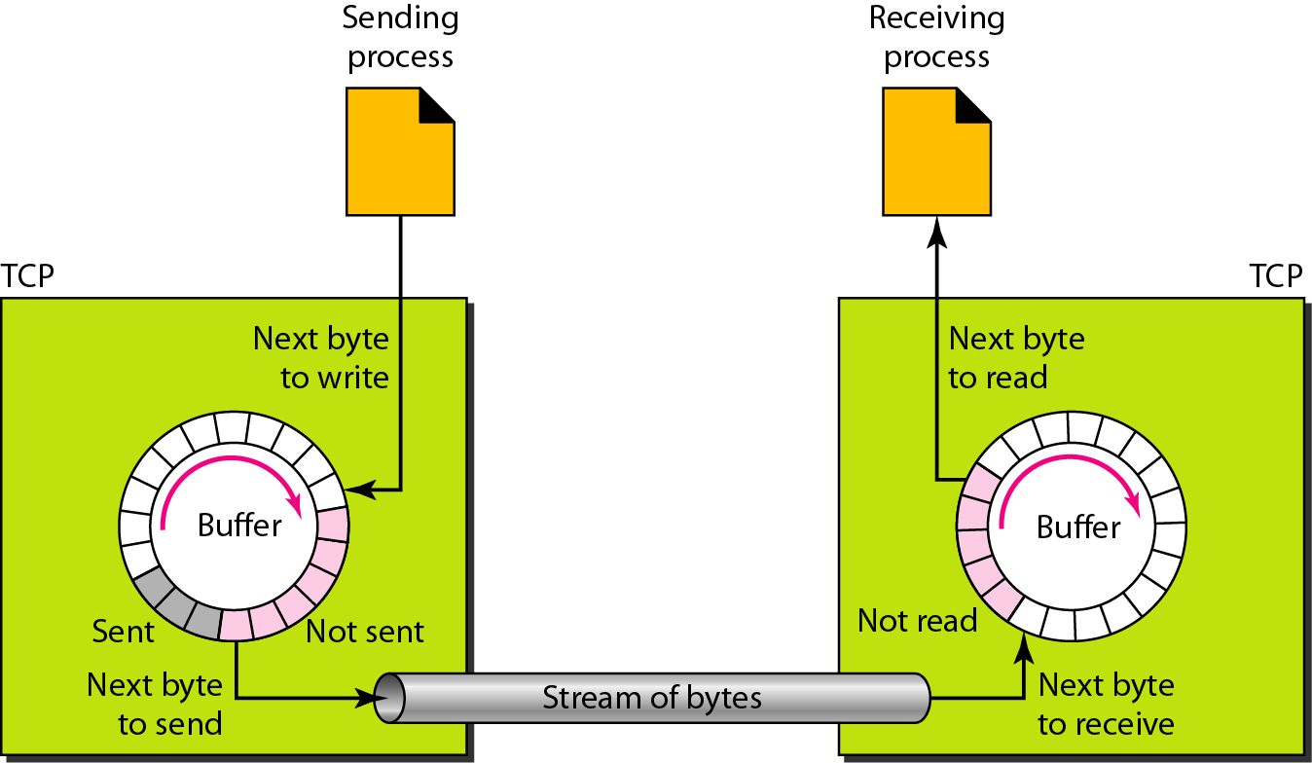
Figure Sending and receiving buffers

Slide 7
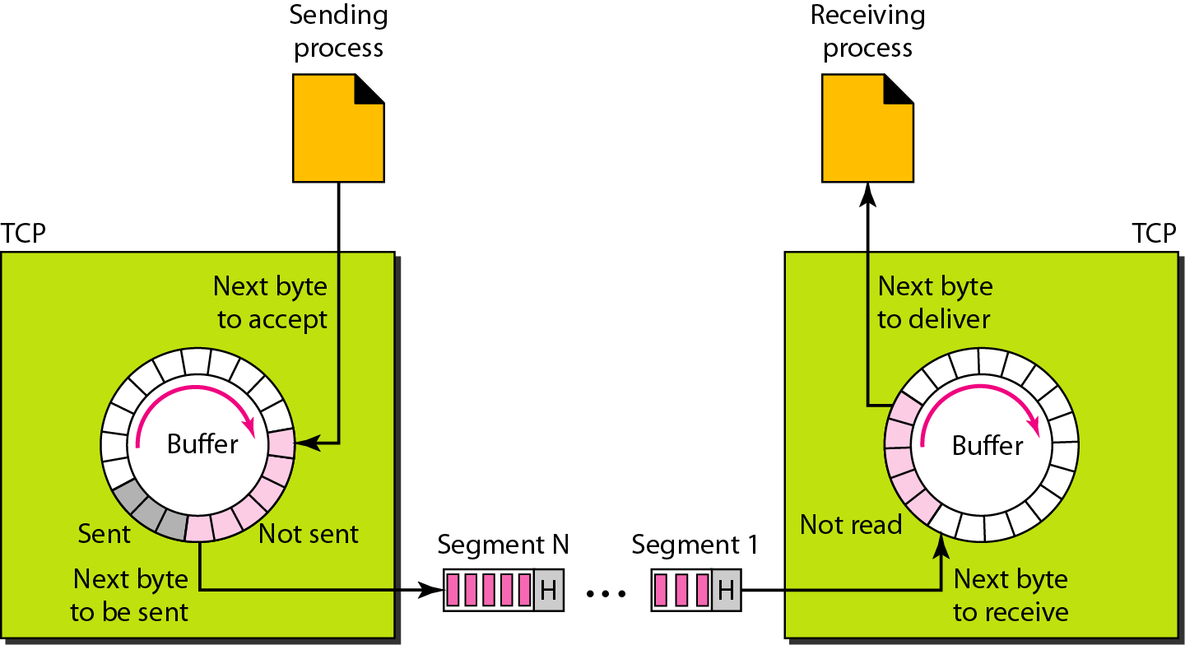
TCP segments

Slide 8

Note
The bytes of data being transferred in each connection are numbered by TCP.
The numbering starts with an arbitrarily generated number. Uses 32 bits.

Slide 9
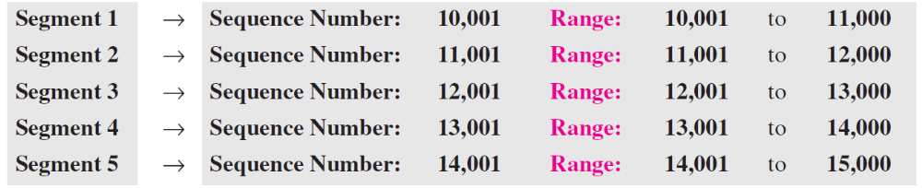
Example 15.1
Suppose a TCP connection is transferring a file of 5,000 bytes. The first byte is numbered 10,001. What are the sequence numbers for each segment if data are sent in five segments, each carrying 1,000 bytes?
Solution
The following shows the sequence number for each segment:

Slide 10
Note
The value in the sequence number
field of a segment defines the number assigned to the first data byte
contained in that segment.

Slide 11
Note
The value of the acknowledgment field in a segment defines the number of the next byte a party expects to receive.
The acknowledgment number is cumulative.

Slide 12
15-3 SEGMENT
Before discussing TCP in more detail, let us discuss the TCP packets themselves. A packet in TCP is called a segment.

Slide 13
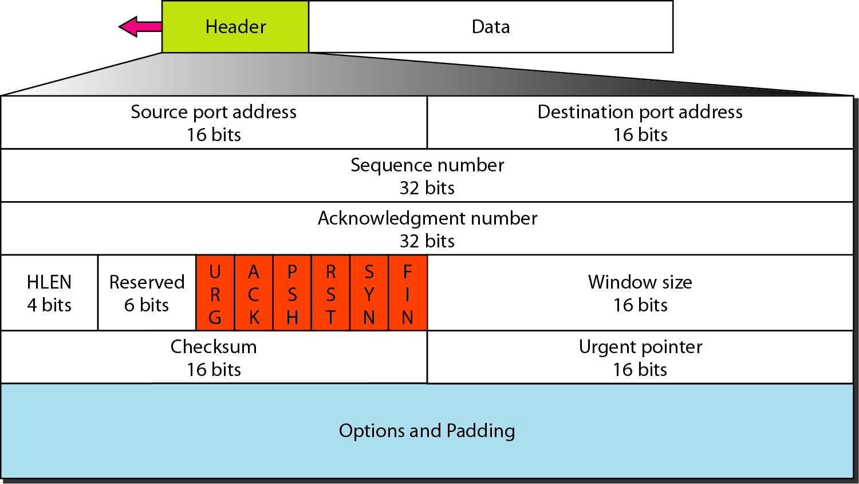
TCP segment format

Slide 14
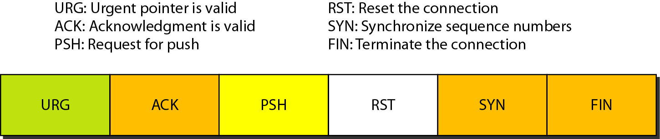
Control field

Slide 15
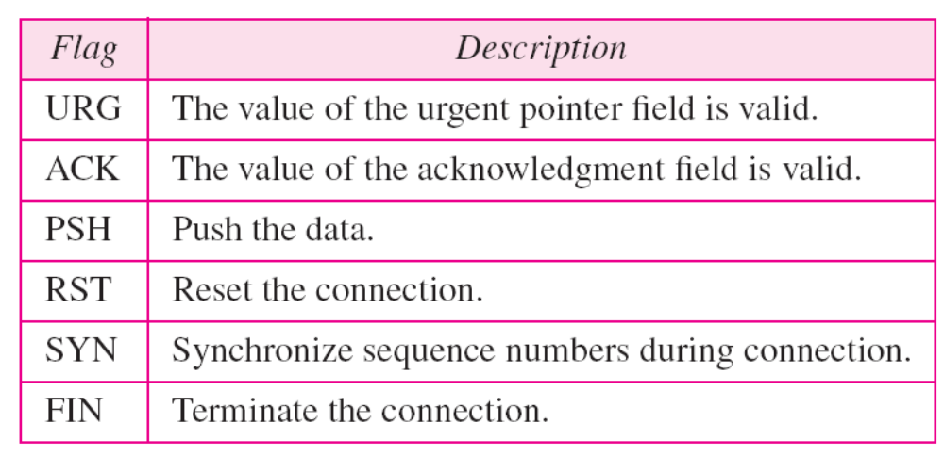
Description of flags in the control field

Slide 16
15-4 A TCP CONNECTION
TCP is connection-oriented. It establishes a virtual path between the source and destination. All of the segments belonging to a message are then sent over this virtual path. You may wonder how TCP, which uses the services of IP, a connectionless protocol, can be connection-oriented. The point is that a TCP connection is virtual, not physical. TCP operates at a higher level. TCP uses the services of IP to deliver individual segments to the receiver, but it controls the connection itself. If a segment is lost or corrupted, it is retransmitted.

Slide 17
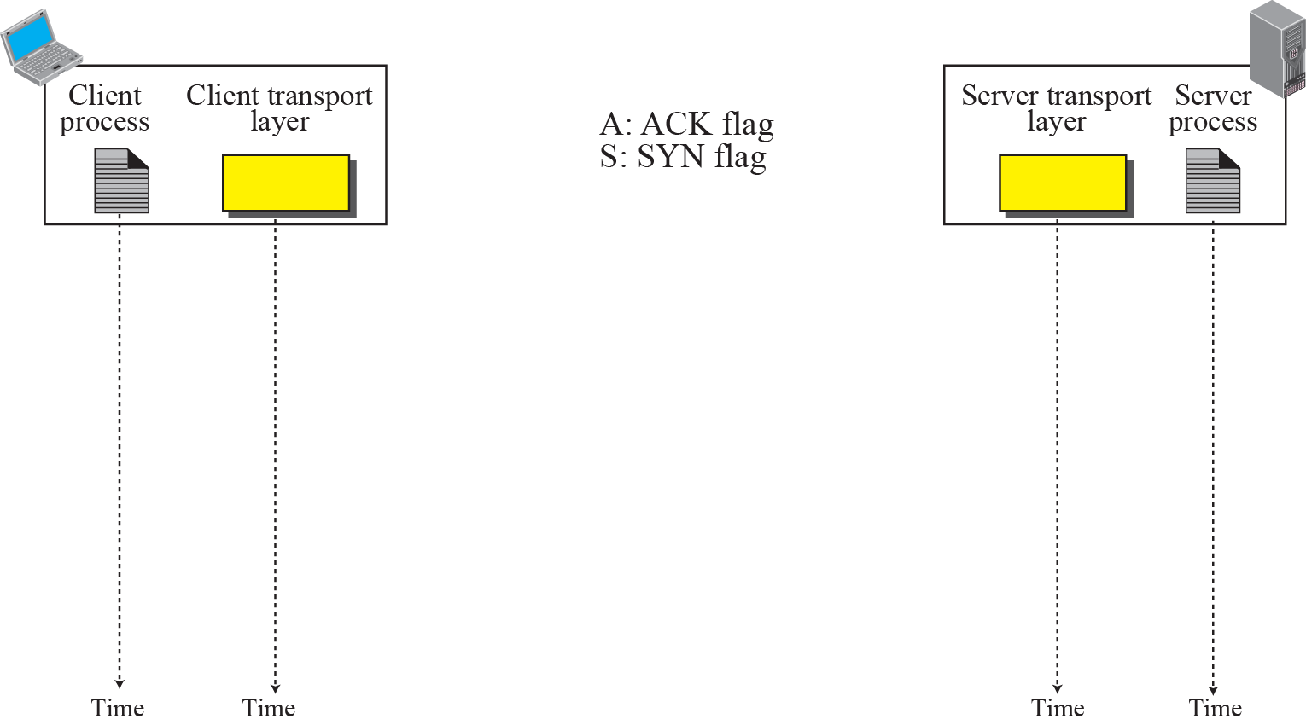
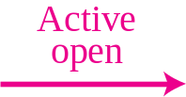
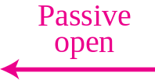
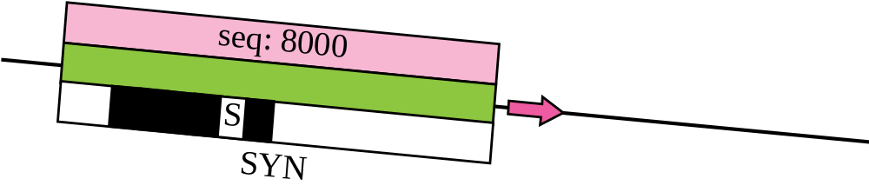
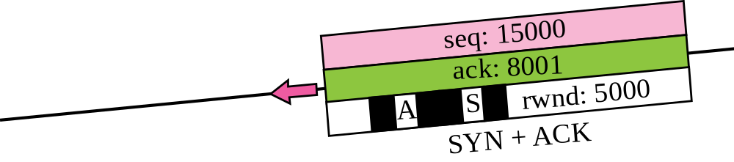
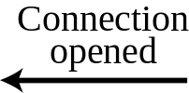
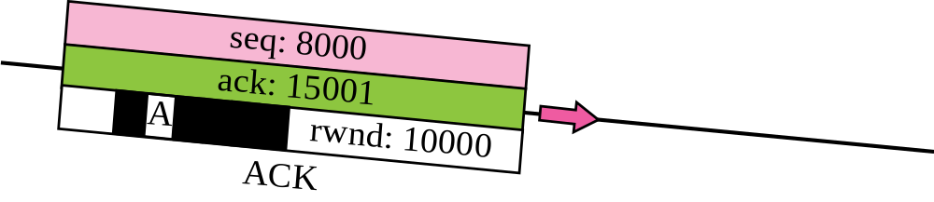

Figure 15.9 Connection establishment using three-way handshake
Means “no data” !
seq: 8001 if piggybacking

Slide 18
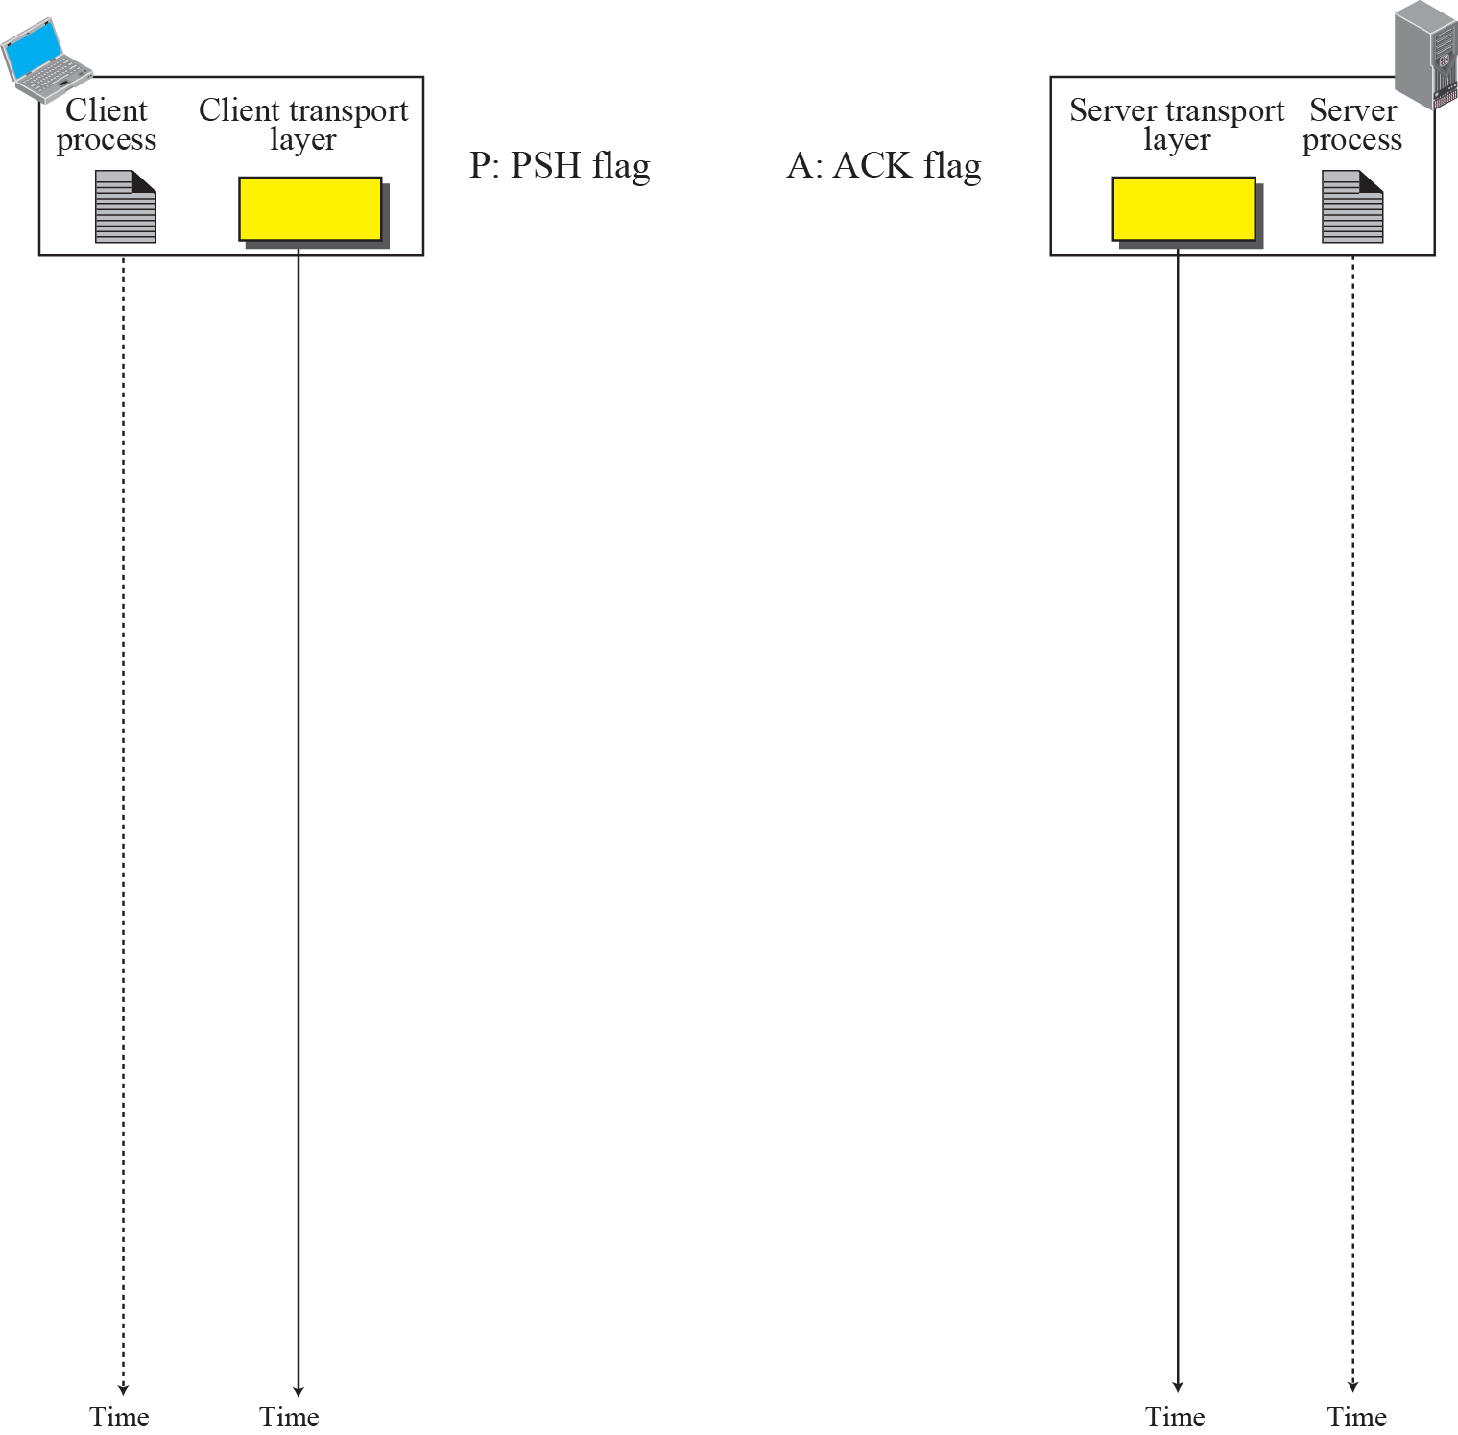
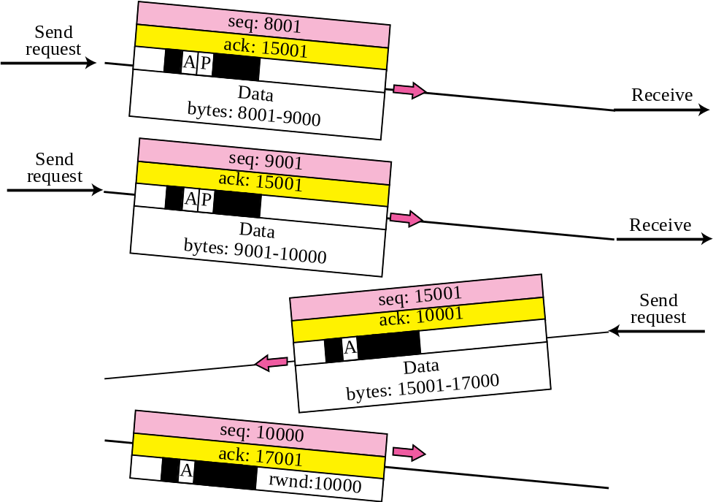

Figure 15.10 Data Transfer
Pushing data
Urgent data

Slide 19
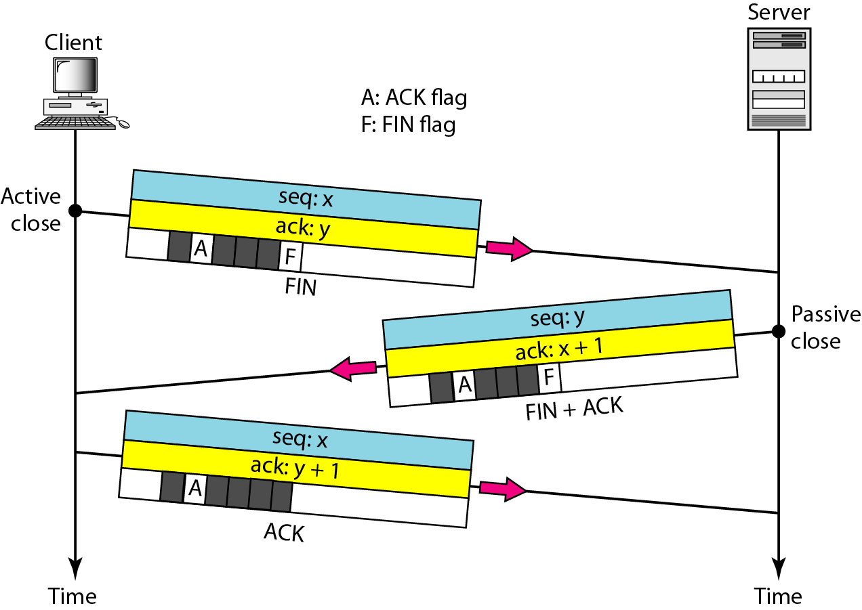
Connection termination using three-way handshaking

